Slide 1
Chapter 12
How to work with tables

Slide 2
Objectives
Applied
Use HTML to create tables with merged cells, captions, headers, and footers.
Use CSS and the CSS3 structural pseudo-classes to format the tables that you create.
Use the HTML5 figure and figcaption elements to treat a table as a figure.
Use HTML to provide accessibility for tables.
Use media queries to make tables responsive.

Slide 3
Objectives (continued)
Knowledge
Describe these components of a table: rows, columns, cells, header cells, data cells, table header, table footer, and table body.
Describe the proper use of tables.
Describe the use of nesting and wrapping with tables.
Describe the use of the table attributes for accessibility.
Describe the use of media queries for making tables responsive.

Slide 4
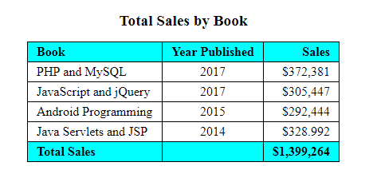
A simple table with basic formatting

Slide 5
The HTML for a table before it’s formatted
<table>
<tr>
<th class="left">Book</th>
<th>Year Published</th>
<th>Sales</th>
</tr>
<tr>
<td class="left">PHP and MySQL</td>
<td>2017</td>
<td>$372,381</td>
</tr>
<tr>
.
.
</tr>

Slide 6
The HTML for a table (continued)
<tr>
<th class="left">Total Sales</th>
<td></td>
<td>$1,399,264</td>
</tr>
</table>

Slide 7
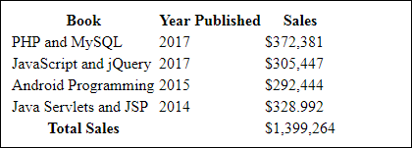
The table in a web browser with no CSS formatting

Slide 8
A table with a header, body, and footer
<thead>
<tr>
<th class="left">Book</th>
<th>Year published</th>
<th>Total sales</th>
</tr>
</thead>
<tbody>
<tr>
<td class="left">PHP and MySQL</td>
<td>2017</td>
<td>$372,381</td>
</tr>
...
</tbody>
<tfoot>
<tr>
<th class="left">Total Sales</th>
<td></td><td>$1,399,264</td>
</tr>
</tfoot>

Slide 9

The unformatted table in a web browser

Slide 10
Common properties for formatting table, tr, th, and td elements
border-collapse
border-spacing
padding
text-align
vertical-align

Slide 11
The CSS for a table
table {
border: 1px solid black;
border-collapse: collapse; }
th, td {
border: 1px solid black;
padding: .2em .7em;
text-align: right; }
th.left, td.left { text-align: left; }
thead, tfoot { background-color: aqua; }
tfoot { font-weight: bold; }

Slide 12
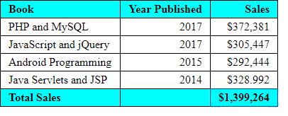
The table in a web browser

Slide 13
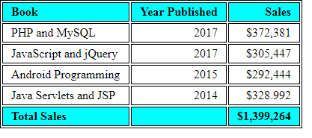
The table without collapsed borders

Slide 14
The CSS3 structural pseudo-class selectors
:nth-child(n)
:nth-last-child(n)
:nth-of-type(n)
:nth-last-of-type(n)
Typical n values
odd
even
n
3n
2n+1
3n+1

Slide 15
CSS3 for table formatting without using classes
th:first-child, td:first-child {
text-align: left;
}
th:nth-child(2), td:nth-child(2) {
text-align: center;
}
tbody tr:nth-child(even) {
background-color: silver;
}

Slide 16
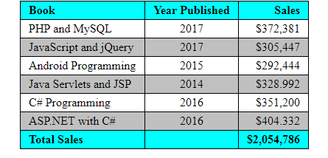
The table in a browser

Slide 17
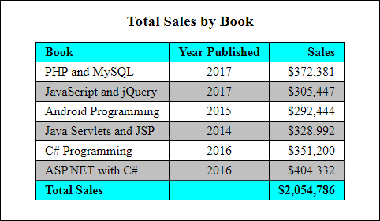
A table within a figure

Slide 18
The HTML for the figure and figcaption elements
<figure>
<figcaption>Total Sales by Book</figcaption>
<table>
.
.
</table>
</figure>

Slide 19
The CSS for the figure and figcaption elements
figure, figcaption {
margin: 0;
padding: 0; }
figure {
border: 1px solid black;
width: 450px;
padding: 15px; }
figcaption {
display: block;
font-weight: bold;
text-align: center;
font-size: 120%;
padding-bottom: .25em; }
table {
border-collapse: collapse;
border: 1px solid black;
margin: 10px auto; }

Slide 20
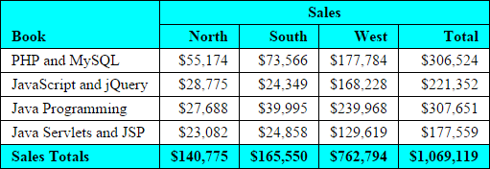
A table with merged cells

Slide 21
The critical HTML for the table
<table>
<thead>
<tr>
<th rowspan="2">Book</th>
<th colspan="4">Sales</th>
</tr>
<tr>
<th>North</th>
<th>South</th>
<th>West</th>
<th>Total</th>
</tr>
</thead>
...
...
</table>

Slide 22
The CSS for the merged cells
th:first-child {
vertical-align: bottom;
}
th:nth-child(2) {
text-align: center;
} tr:nth-child(2) th {
text-align: right;
}

Slide 23
A table that provides for accessibility
<caption>Total sales from 2012 to 2017</caption>
<thead>
<tr>
<th id="hdr_book" scope="col">Book</th>
<th id="hdr_year" scope="col">Year Published</th>
<th id="hdr_sales" scope="col">Sales</th></tr>
</thead>
<tbody>
<tr>
<td headers="hdr_book">PHP and MySQL</td>
<td headers="hdr_year">2017</td>
<td headers="hdr_sales">$372,381</td></tr>
...
</tbody>
<tfoot>
<tr>
<th id="hdr_total" scope="row">Total Sales</th>
<td></td>
<td headers="hdr_sales hdr_total">...</td></tr>
</tfoot>

Slide 24
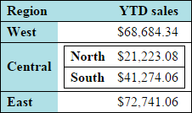
A table with a second table nested within one of its cells

Slide 25
The HTML for the nesting
<table id="outer">
<caption>YTD Sales by Region</caption>
<tr>
<th>Region</th>
<th>YTD sales</th></tr>
<tr>
<th>West</th>
<td>$68,684.34</td></tr>
<tr>
<th>Central</th>
<td>
<table id="inner">
<tr>
<th>North</th>
<td>$21,223.08</td></tr>
<tr>
<th>South</th>
<td>$41,274.06</td></tr>
</table>
</td>
</tr>

Slide 26
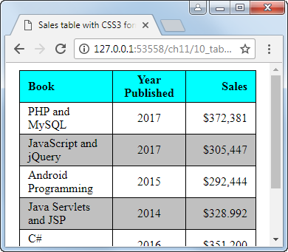
A table with wrapping

Slide 27
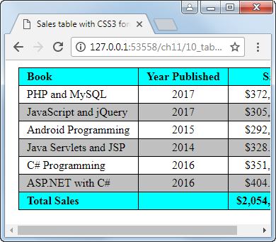
A table without wrapping

Slide 28
The property that stops wrapping
table { white-space: nowrap; }

Slide 29
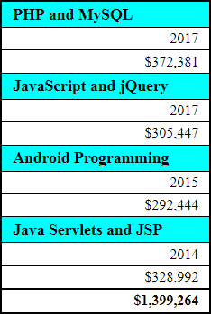
A table after it’s reformatted for smaller screens

Slide 30
The media query for the table
@media only screen and (max-width: 479px) {
th, td { display: block; }
thead { display: none; }
tr td:first-child {
font-weight: bold;
font-size: 110%;
background-color: aqua;
}
tbody td {
border-bottom-style: none;
}
tfoot {
background-color: white;
border: none;
border-top: 1px solid black;
}
tfoot th, tfoot td:nth-of-type(1) {
display: none;
}
}

Slide 31
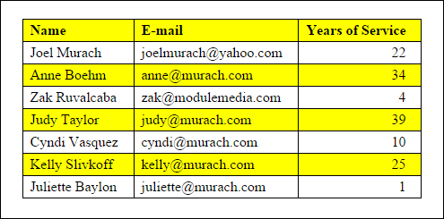
Short 12-1 Enhance a table (part 1)

Slide 32
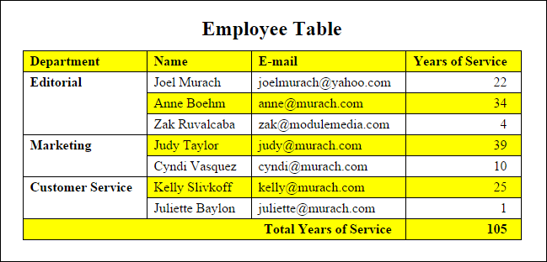
Short 12-1 Enhance a table (part 2)

